Slide 1
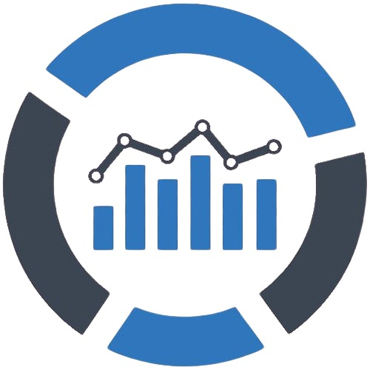

HR ANALYTICS
Group - 2
Presented By :
V. Retesh Kumar
Repaka Madhu
Anyam Sahithi
Sandha Susmitha
Suravajjala Snehita
Sandesh Bandaru
Kalyanapu Manikanta

Slide 2
TABLE OF CONTENTS
Introduction
Objectives
Exploratory data analysis
Data Modelling
Key Performance Indicators
Recommendations
Dashboard

Slide 3
INTRODUCTION
This presentation analyzes HR datasets to gain insights into employee performance and retention. By examining this data, we aim to identify patterns in employee satisfaction, turnover, and the effectiveness of HR initiatives.
The focus of the analysis is on understanding employee retention across various departments, job roles, and age groups. Interactive dashboards will be created using Power BI, Tableau, and Excel to visualize these insights.
These visualizations will help in pinpointing key areas that require attention and allow for the development of targeted strategies to improve employee engagement. The ultimate goal is to leverage these findings to foster a more motivated and efficient workforce, ultimately driving the company’s success.

Slide 4
OBJECTIVES
The primary objective of our HR Analytics project was to analyze Employee Retention by calculating the attrition rate across various dimensions, including department, job role, age group, monthly income, education field, and years since the last promotion.
The analysis also incorporates additional insights to provide a comprehensive understanding of the factors influencing employee turnover.
By identifying the key factors contributing to employee turnover, the project aims to provide actionable insights that can guide the development of effective retention strategies.

Slide 5
EXPLORATORY DATA ANALYSIS
There were 2 datasets (HR_1 , HR_2) which were provided, consists of employee data from an organization, which can be used to analyze employee retention and other factors influencing Employee Relations
HR_1 Overview:
Key Features: Includes demographic details (Age, Gender), job-related information (JobRole, JobLevel, Department), and job satisfaction indicators (JobSatisfaction, EnvironmentSatisfaction).
HR_2 Overview:
Key Features: Contains information about employee compensation (MonthlyIncome, PercentSalaryHike), work experience (TotalWorkingYears, YearsAtCompany), and work-life balance metrics (WorkLifeBalance, OverTime).
The tools/accelerators which were used for the project are :-
MS Excel
Power BI
SQL
Tableau

Slide 6
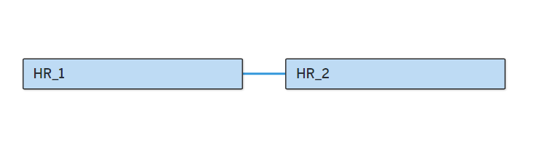
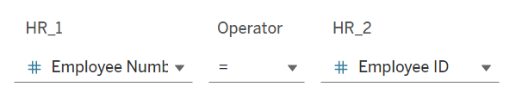
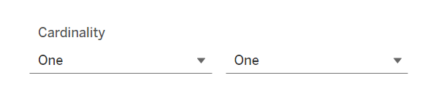
DATA MODELLING
We have created a relationship Between HR_1 and HR_2 with Employee Number and Employee ID as the Unique Identifiers
We have used One To One cardinality for our analysis

Slide 7
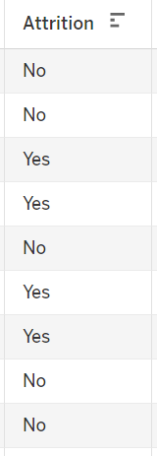
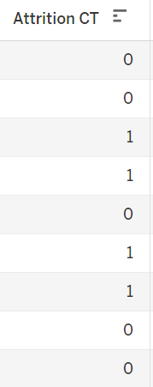
The primary goal of analyzing employee retention is to focus on the attrition data, which is categorized as 'Yes' or 'No' in our dataset. To facilitate analysis, we created a measure that converts these 'Yes' and 'No' values into 0s and 1s. Additionally, we calculated the attrition rate by dividing the total number of attritions by the total number of employees
We also created five distinct age groups to analyze employee retention across different age demographics.

Slide 8
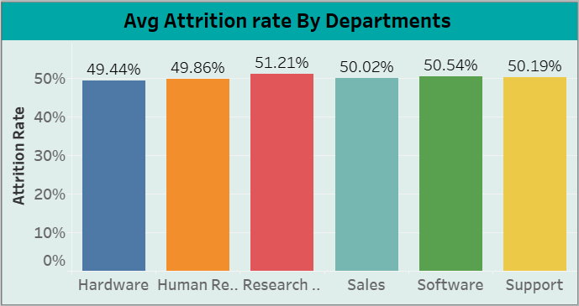
KPI - 1
Avg Attrition Rate By Dept.
Our organization comprises six different departments, and we calculated the average employee retention for each.
The Research and Development department had the highest average retention, followed by Software, Support, and others.
The Hardware department had the lowest average retention.

Slide 9
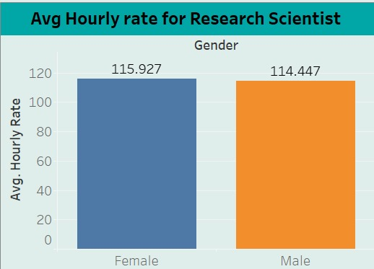
KPI - 2
Avg. Hourly rate of Research Scientist
Research Scientists play a critical role in the organization, focusing on developing and innovating new products, processes, or solutions.
The average hourly rate for Research Scientists is ₹114.45 for males and ₹115.93 for females. This slight difference highlights a relatively balanced pay structure for this role within the organization.

Slide 10
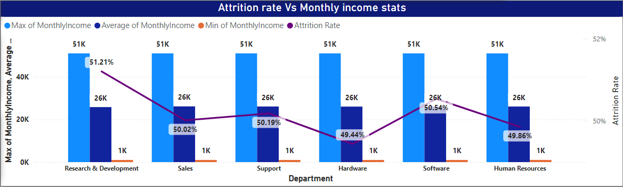
KPI - 3
Attrition rate Vs Monthly income stats
Research & Development has the highest attrition rate (51.21%), suggesting potential retention issues despite consistent income levels across departments.
Sales and Human Resources have the lowest attrition rates (~50%), indicating better employee retention compared to other departments.

Slide 11
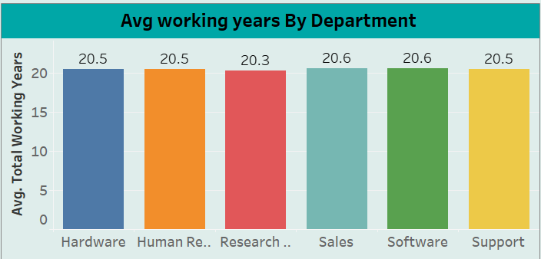
KPI - 4
Average working years for each Department
Our organization comprises six different departments, and we calculated the average Working Years for each.
The Sales and Software department had the highest average Working Years, followed by Hardware, Support, and Human Resources.
The Research and Development department had the lowest average Working Years.

Slide 12
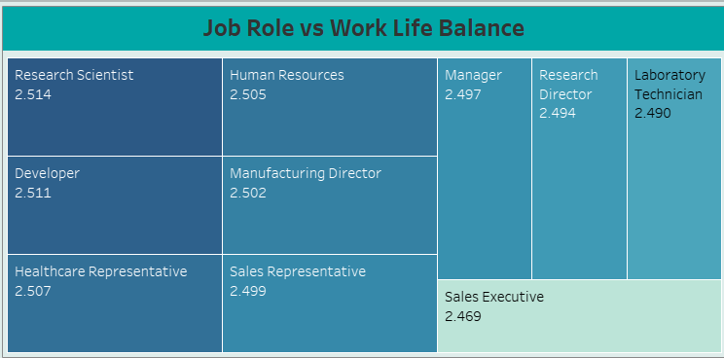
KPI - 5
Job Role Vs Work life balance
Research Scientists have the best work-life balance (2.514), followed closely by Developers (2.511), indicating better job satisfaction in these roles.
Sales Executives have the poorest work-life balance (2.469), suggesting potential issues with workload or expectations.
The work-life balance for Managers and Research Directors is relatively low, indicating potential areas for improvement in these leadership roles.

Slide 13
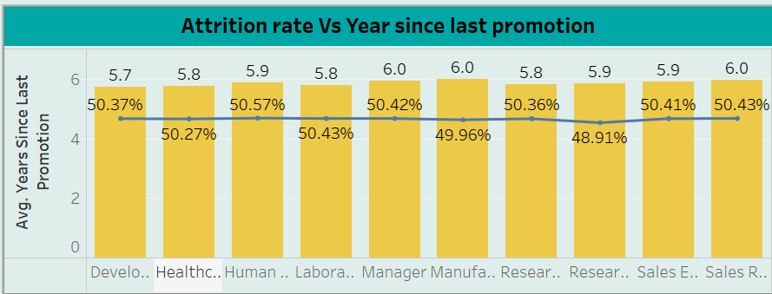
KPI - 6
Attrition rate Vs Year since last promotion relation
attrition rate remains consistently around 50% across various job roles, indicating a uniform turnover rate regardless of the job function.
The average years since the last promotion slightly vary across roles, ranging from 5.7 to 6.0 years, but this does not significantly affect the attrition rate.
The attrition rate in "Research" roles (48.91%) is marginally lower compared to other sectors,

Slide 14
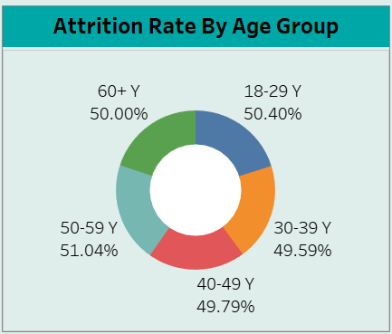
KPI - 7
Attrition Rate by Age Group
The attrition rate is fairly uniform across all age groups, with rates ranging between 49.59% and 51.04%, showing no significant age-related variance in turnover.
Employees aged 50-59 years have the highest attrition rate at 51.04%, which may indicate a higher tendency to leave or retire.
The 30-39 age group has the lowest attrition rate at 49.59%, potentially indicating higher job stability within this demographic

Slide 15
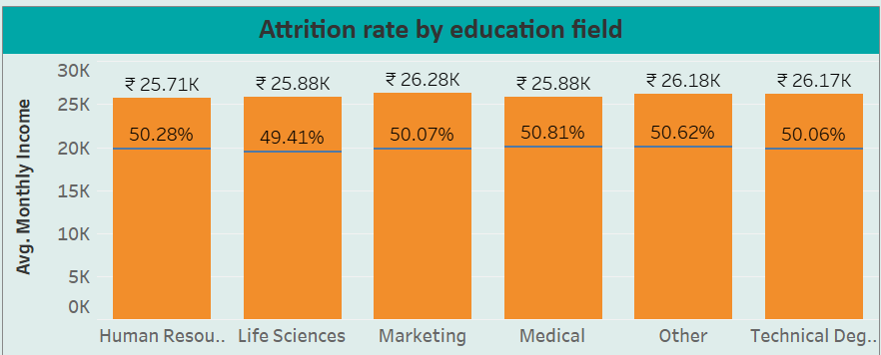
KPI - 8
Attrition Rate by Education Field
The attrition rate across different education fields remains relatively consistent, ranging between 49.41% to 50.81%, indicating uniform employee turnover rates regardless of educational background.
There is slight variation in average monthly income across fields, with the lowest being ₹25.71K in Human Resources and the highest being ₹26.28K in Marketing, reflecting minor income differences across sectors.
The Medical field, despite offering a moderate average monthly income of ₹25.88K, exhibits the highest attrition rate at 50.81%, suggesting potential dissatisfaction or challenges in this sector.

Slide 16
RECOMMENDATION
Flexible Work & Wellness Programs: Introduce flexible hours, remote work, and tailored wellness initiatives to improve employee morale and well-being.
Career Development & Promotion: Implement more frequent promotion cycles and provide targeted training programs to support clear career progression paths.
Competitive Compensation & Benefits: Regularly adjust salaries and offer enhanced non-monetary benefits like additional leave and health insurance.
Positive Work Environment: Foster team-building, recognize employee achievements, and ensure managers are trained in leadership and communication skills.

Slide 17
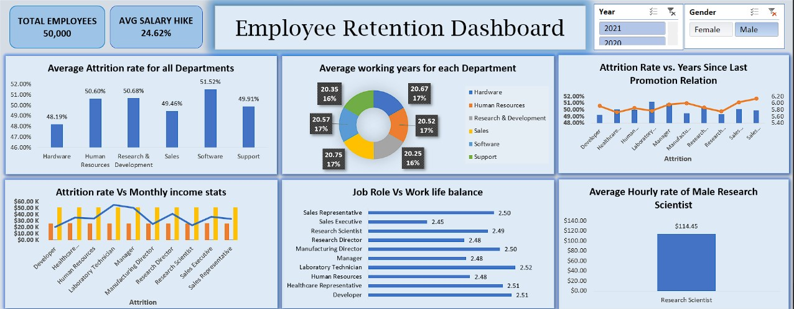
EXCEL DASHBOARD

Slide 18
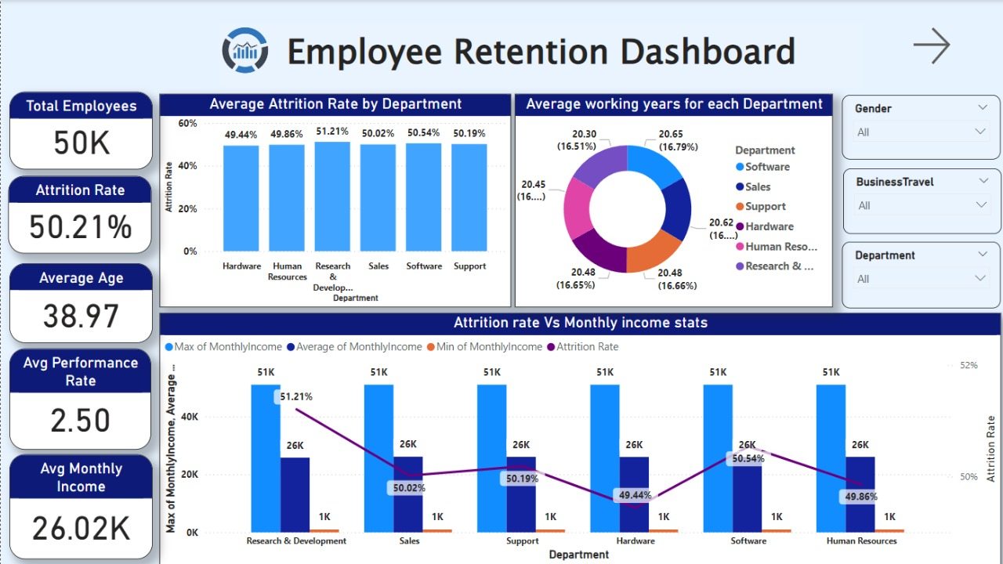
POWER BI DASHBOARD

Slide 19
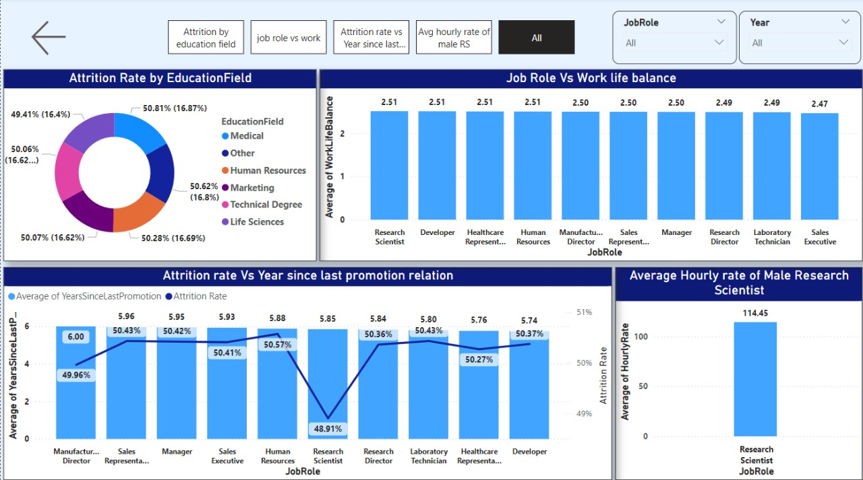

Slide 20
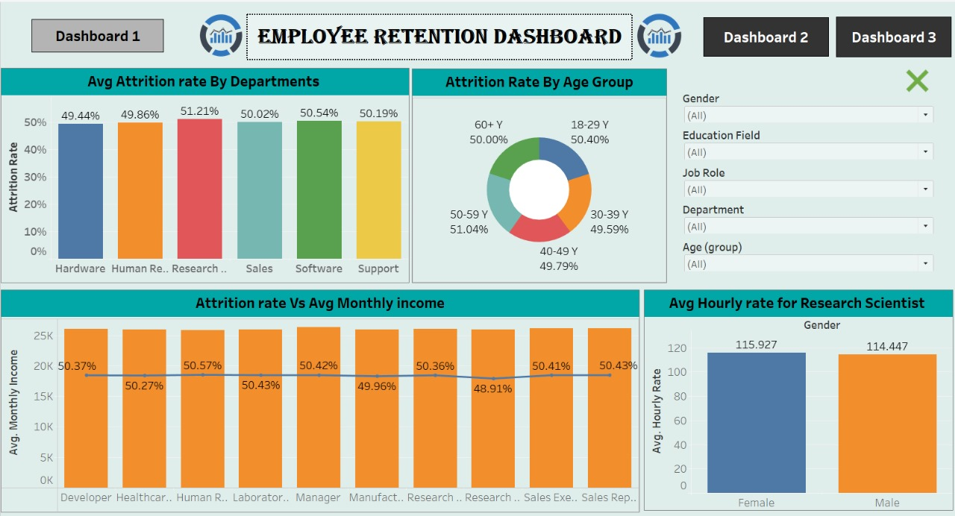
TABLEAU DASHBOARD

Slide 21
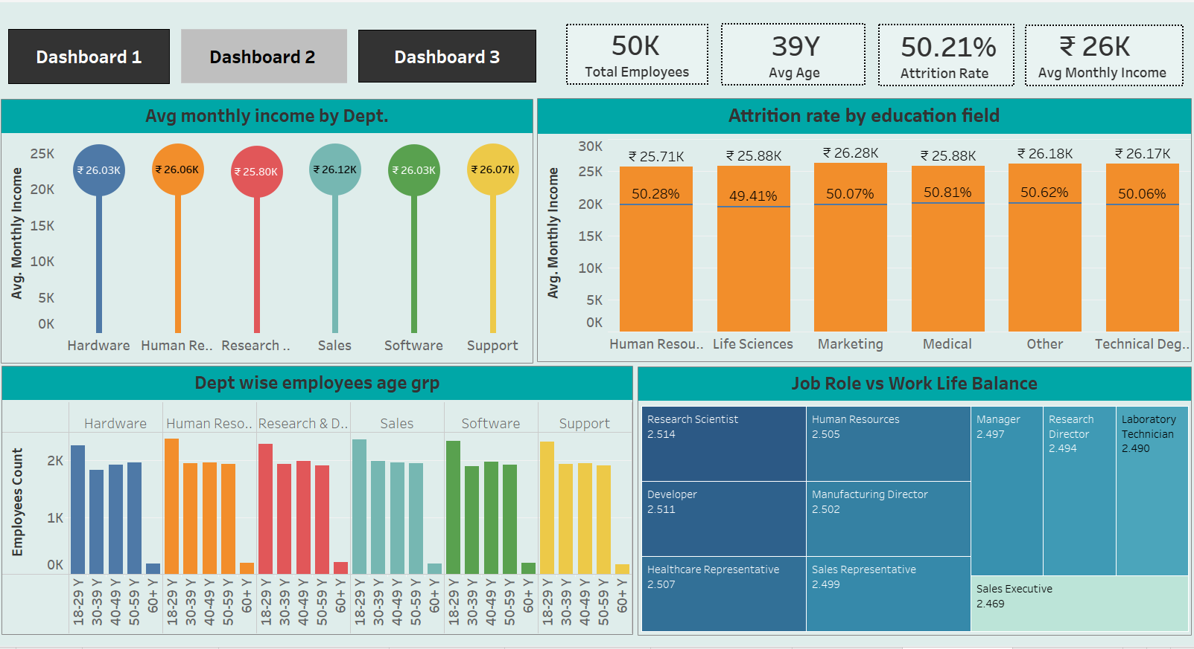

Slide 22
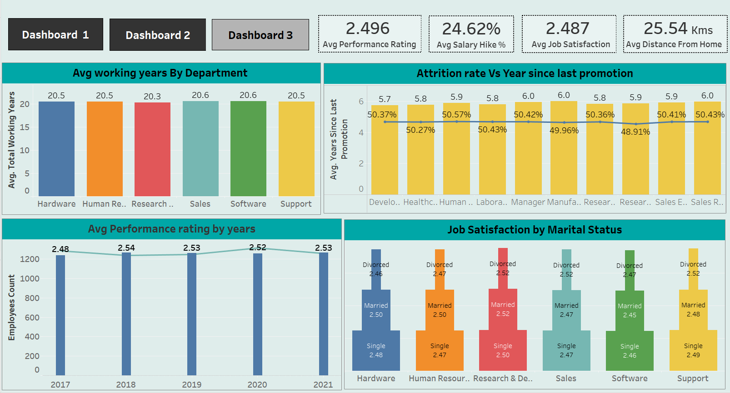

Slide 23


